Slide 1
Programming with Java
Instructor : Neelima Gupta
Notes:
First Class: Introduction, Prerequisites, Advices, Syllabus
Lab 1: Create a Java Project, Compile, and Run.
Show syntax errors
Print program
Capture screen shots, and save it in Word, and print it.
Homework One: Check in the class randomly.

Slide 2
Introduction to Java
What Is Java?
Getting Started With Java Programming
Create, Compile and Running a Java Application
‹#›

Slide 3
Characteristics of Java
Java is simple
Java is object-oriented
Java is distributed
Java is interpreted
Java is robust
Java is secure
Java is architecture-neutral
Java is portable
Java’s performance
Java is multithreaded
Java is dynamic
‹#›

Slide 4
Getting Started with Java Programming
A Simple Java Application
Compiling Programs
Executing Applications
‹#›

Slide 5
A Simple Application
Example 1.1
//This application program prints Welcome
//to Java!
package chapter1;
public class Welcome {
public static void main(String[] args) {
System.out.println("Welcome to Java!");
}
}
‹#›

Slide 6
Anatomy of a Java Program
Comments
Reserved words
Modifiers
Statements
Blocks
Classes
Methods
The main method
The exit method
‹#›

Slide 7
Comments
In Java, comments are preceded by two slashes (//) in a line, or enclosed between /* and */ in one or multiple lines. When the compiler sees //, it ignores all text after // in the same line. When it sees /*, it scans for the next */ and ignores any text between /* and */.
‹#›

Slide 8
Reserved Words
Reserved words or keywords are words that have a specific meaning to the compiler and cannot be used for other purposes in the program. For example, when the compiler sees the word class, it understands that the word after class is the name for the class. Other reserved words in Example 1.1 are public, static, and void. Their use will be introduced later.
‹#›

Slide 9
Modifiers
Java uses certain reserved words called modifiers that specify the properties of the data, methods, and classes and how they can be used. Examples of modifiers are public and static. Other modifiers are private, final, abstract, and protected. A public datum, method, or class can be accessed by other programs. A private datum or method cannot be accessed by other programs.
‹#›

Slide 10
Statements
A statement represents an action or a sequence of actions. The statement System.out.println("Welcome to Java!"); in the program in Example 1.1 is a statement to display the greeting "Welcome to Java!" Every statement in Java ends with a semicolon (;).
‹#›

Slide 11
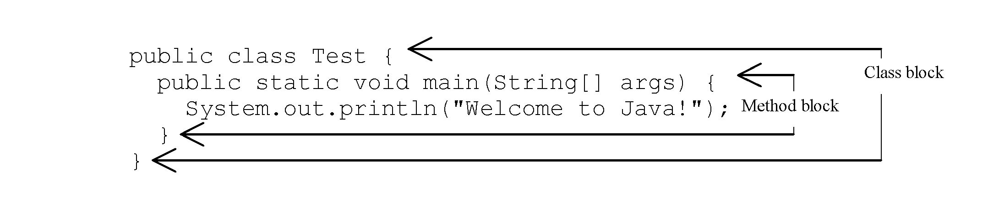
Blocks
A pair of braces in a program forms a block that groups components of a program.
‹#›

Slide 12
Classes
The class is the essential Java construct. A class is a template or blueprint for objects.
A java program is defined by using one or more classes.
‹#›

Slide 13
Methods
What is System.out.println? It is a method: a collection of statements that performs a sequence of operations to display a message on the console.
It can be used even without fully understanding the details of how it works.
It is used by invoking a statement with a string argument. The string argument is enclosed within parentheses. In this case, the argument is "Welcome to Java!"
You can call the same println method with a different argument to print a different message.
‹#›

Slide 14
main Method
The main method provides the control of program flow. The Java interpreter executes the application by invoking the main method.
The main method looks like this:
public static void main(String[] args) {
// Statements; }
‹#›

Slide 15
The exit Method
Use Exit to terminate the program and stop all threads.
When your program starts, a thread is spawned to run the program. To terminate the thread, you have to invoke the exit method.
‹#›

Slide 16
Identifiers
An identifier is a sequence of characters that consist of letters, digits, underscores (_), and dollar signs ($).
An identifier must start with a letter, an underscore (_), or a dollar sign ($). It cannot start with a digit.
An identifier cannot be a reserved word. (See Appendix A, “Java Keywords,” for a list of reserved words).
An identifier cannot be true, false, or null.
An identifier can be of any length.
‹#›

Slide 17
Primitive Data Types and Operations
Introduce Programming with an Example
Identifiers, Variables, and Constants
Primitive Data Types
byte, short, int, long, float, double, char, boolean
Expressions
Operators, Precedence, Associativity, Operand Evaluation Order: ++, --, *, /, %, +=, -=, *=, /=, %=, ^, &, |, +, -,
Getting Input from Input Dialog Boxes
Case Studies (Computing Mortgage, and Computing Changes)
Style and Documentation Guidelines
Syntax Errors, Runtime Errors, and Logic Errors
‹#›

Slide 18
Variables
// Compute the first area
radius = 1.0;
area = radius*radius*3.14159;
System.out.println("The area is “ + area + " for radius "+radius);
// Compute the second area
radius = 2.0;
area = radius*radius*3.14159;
System.out.println("The area is “ + area + " for radius "+radius);
‹#›

Slide 19
Declaring Variables
int x; // Declare x to be an
// integer variable;
double radius; // Declare radius to
// be a double variable;
char a; // Declare a to be a
// character variable;
‹#›

Slide 20
Numerical Data Types (p.33)
byte 8 bits
short 16 bits
int 32 bits
long 64 bits
float 32 bits
double 64 bits
‹#›

Slide 21
Assignment Statements
x = 1; // Assign 1 to x;
radius = 1.0; // Assign 1.0 to radius;
a = 'A'; // Assign 'A' to a;
‹#›

Slide 22
Declaring and Initializing in One Step
int x = 1;
double d = 1.4;
float f = 1.4;
Is this statement correct?
‹#›

Slide 23
Constants
final datatype CONSTANTNAME = VALUE;
final double PI = 3.14159;
final int SIZE = 3;
‹#›

Slide 24
Operators
+, -, *, /, and %
5/2 yields an integer 2.
5.0/2 yields a double value 2.5
5 % 2 yields 1 (the remainder of the division)
5.0 % 2 is not defined : modulo is defined only for integers.
‹#›

Slide 25
NOTE
Calculations involving floating-point numbers are approximated because these numbers are not stored with complete accuracy. For example,
System.out.println(1 - 0.1 - 0.1 - 0.1 - 0.1 - 0.1);
displays 0.5000000000000001, not 0.5, and
System.out.println(1.0 - 0.9);
displays 0.09999999999999998, not 0.1. Integers are stored precisely. Therefore, calculations with integers yield a precise integer result.
‹#›

Slide 26
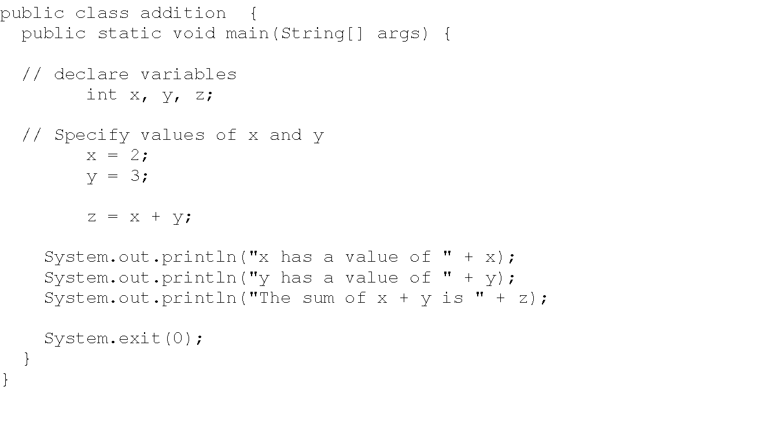
Example Program 1: Addition
‹#›

Slide 27
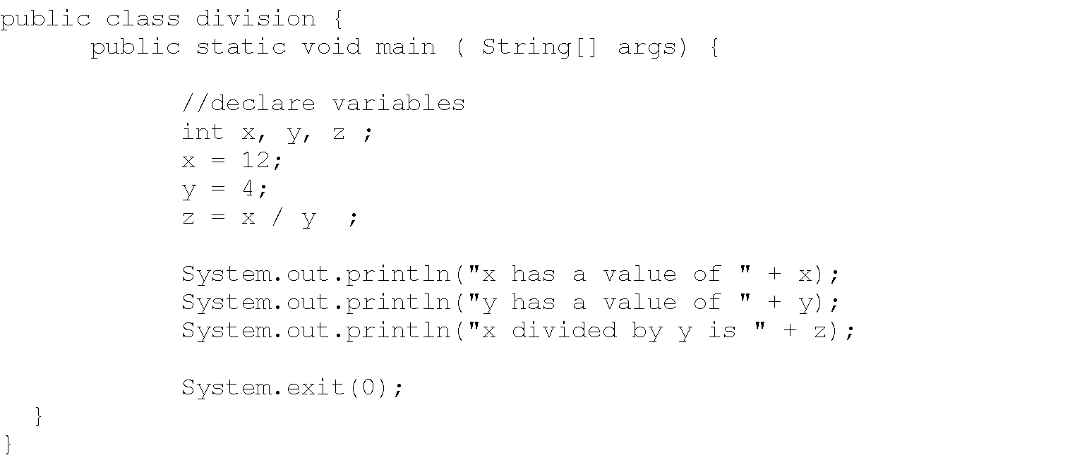
Example Program 2 : Division
‹#›

Slide 28
Download Java
From www.java.sun.com/j2se
Click on j2se 5.0
See on your right (popular downloads) ..click on j2se 5.0
Click on download jdk 5.0 update 3
Accept the agreement and continue
Download the version as per your platform
For example, for Windows click on Windows offline installation – this will download the required file .. This will take a lot of time .. depending upon the speed of your line .. Once downloaded ..run this file to install Java
‹#›

Slide 29
Compiling and Running a Java Program
Java source code files (files with a .java extension) are compiled into a format called bytecode (files with a .class extension), which can then be executed by a Java interpreter. Compiled Java code can run on most computers because Java interpreters and runtime environments, known as Java Virtual Machines (VMs), exist for most operating systems, including UNIX, the MACintosh OS, and Windows. Bytecode can also be converted directly into machine language instructions by a just-in-time compiler (JIT).
‹#›

Slide 30
For Example
Create a file named say .. addition.java using some editor say wordpad.
From the command line type the following
javac addition.java (java code compiled to a bytecode)
A file called addition.class(bytecode) is created,
Now type
java addition (bytecode being executed by java interpreter)
And you will get the results
‹#›

Slide 31
Number Literals
A literal is a constant value that appears directly in the program. For example, 34, 1,000,000, and 5.0 are literals in the following statements:
int i = 34;
long l = 1000000;
double d = 5.0;
‹#›

Slide 32
Shortcut Assignment Operators
Operator Example Equivalent
+= i+=8 i = i+8
-= f-=8.0 f = f-8.0
*= i*=8 i = i*8
/= i/=8 i = i/8
%= i%=8 i = i%8
‹#›

Slide 33
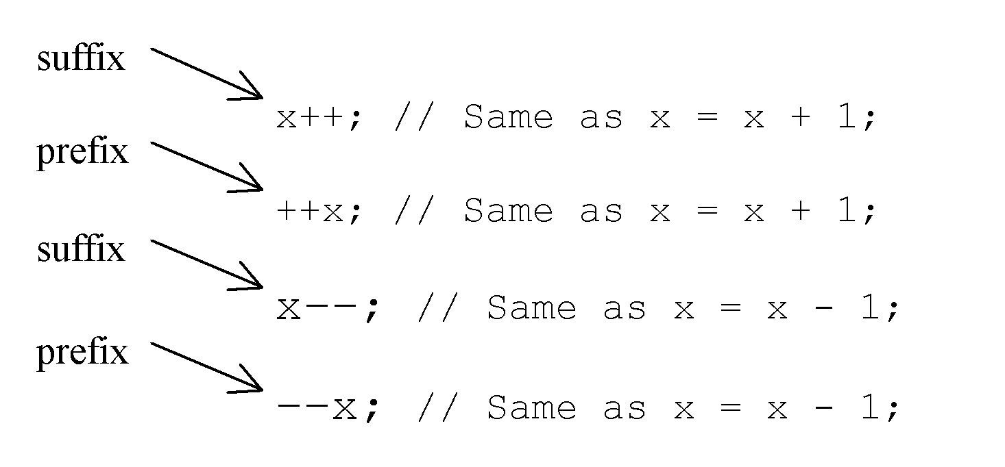
Increment and Decrement Operators
‹#›

Slide 34
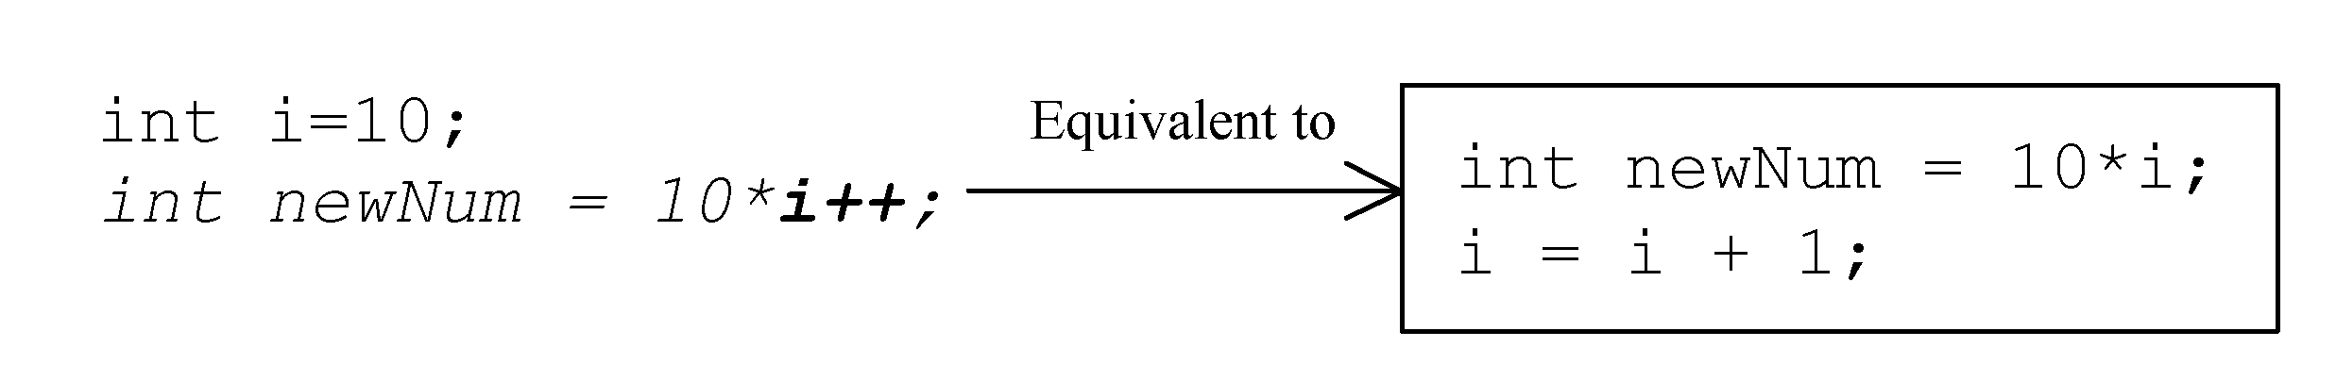
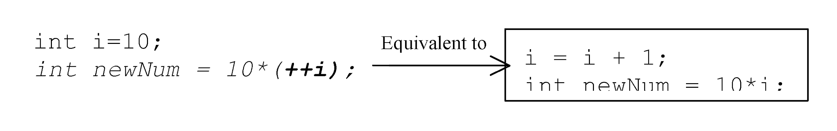
Increment and Decrement Operators, cont.
‹#›

Slide 35
Increment and Decrement Operators, cont.
Using increment and decrement operators makes expressions short, but it also makes them complex and difficult to read.
Avoid using these operators in expressions that modify multiple variables, or the same variable for multiple times such as this: int k = ++i + i. Its not a good programming practice.
‹#›

Slide 36
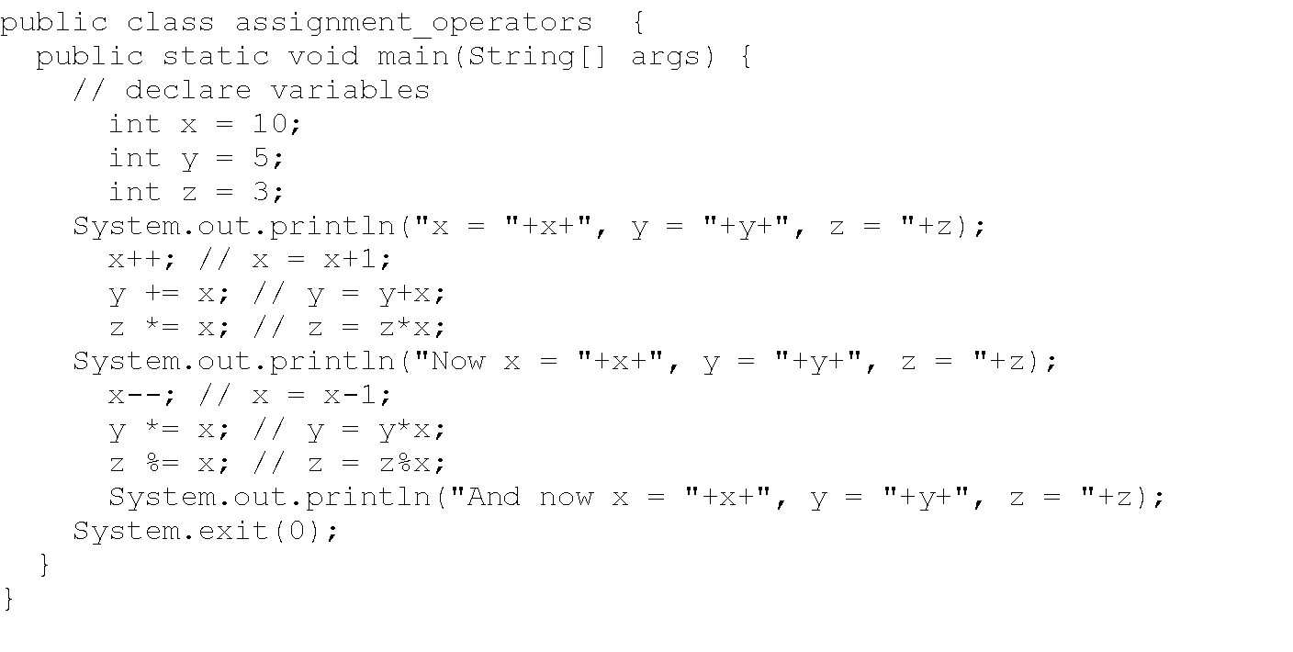
‹#›

Slide 37
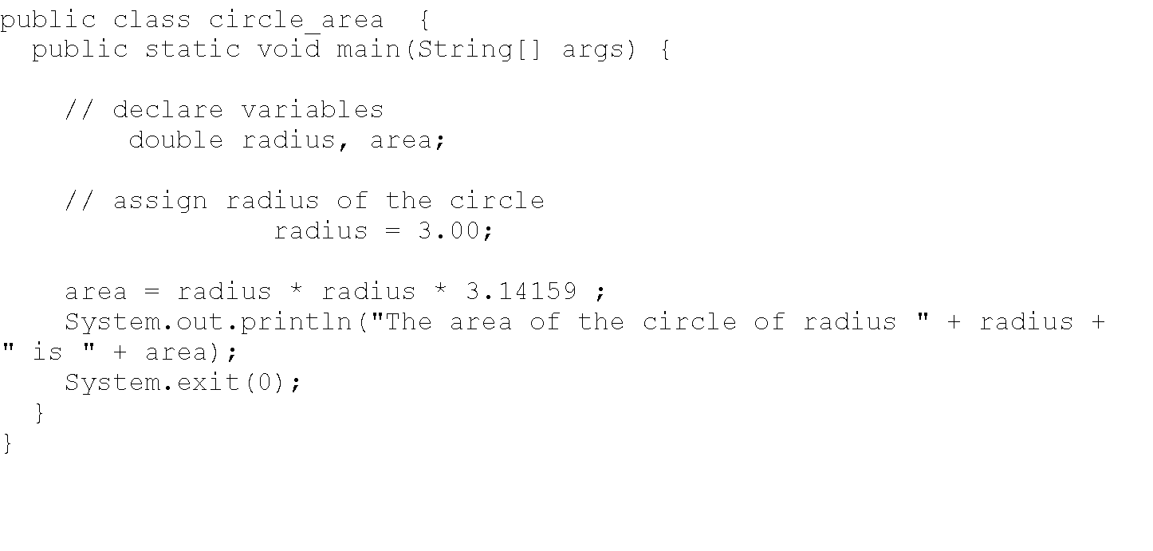
‹#›

Slide 38
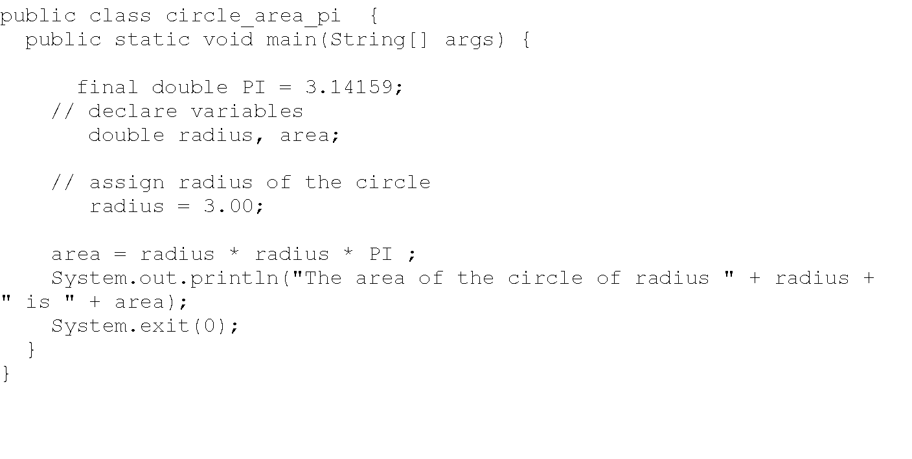
‹#›

Slide 39
Assignment Expressions and Assignment Statements
Prior to Java 2, all the expressions can be used as statements. Since Java 2, only the following types of expressions can be statements:
variable op= expression; // Where op is +, -, *, /, or %
++variable;
variable++;
--variable;
variable--;
‹#›

Slide 40
Numeric Type Conversion
Consider the following statements:
byte i = 100;
long k = i*3+4;
double d = i*3.1+k/2;
int x = k; //(Wrong)
long k = x; //(fine,implicit casting)
‹#›

Slide 41
Type Casting
double
float
long
int
short
byte
‹#›

Slide 42
Type Casting, cont.
Implicit casting
double d = 3; (type widening)
Explicit casting
int i = (int)3.0; (type narrowing)
What is wrong? int x = 5/2.0;
‹#›

Slide 43
Answer
Needs explicit type cast
int x = (int) 5/2.0;
‹#›

Slide 44
Character Data Type
char letter = 'A'; (ASCII)
char numChar = '4'; (ASCII)
char letter = '\u0041'; (Unicode)
char numChar = '\u0034'; (Unicode)
Special characters
char tab = ‘\t’;
‹#›

Slide 45
Casting between char and Numeric Types
int i = 'a'; // Same as int i = (int)'a';
char c = 97; // Same as char c = (char)97;
‹#›

Slide 46
The boolean Type and Operators
boolean lightsOn = true;
boolean lightsOn = false;
boolean b = (1 > 2);
&& (and) (1 < x) && (x < 100)
|| (or) (lightsOn) || (isDayTime)
! (not) !(isStopped)
‹#›

Slide 47
Comparison Operators
Operator Name
< less than
<= less than or equal to
> greater than
>= greater than or equal to
== equal to
!= not equal to
‹#›

Slide 48
Boolean Operators
Operator Name
! not
&& and
|| or
^ exclusive or
‹#›

Slide 49
Truth Table for Operator !
Truth Table for Operator !
Operand !Operand
true false
false true
‹#›

Slide 50
Truth Table for Operator &&
Operand1 Operand2 Operand1 && Operand2
false false false
false true false
true false false
true true true
‹#›

Slide 51
Truth Table for Operator ||
Operand1 Operand2 Operand1 || Operand2
false false false
false true true
true false true
true true true
‹#›

Slide 52
Operator Precedence
How to evaluate
3 + 4 * 4 > 5 * (4 + 3) - ++i
‹#›

Slide 53
Operator Precedence
var++, var--
+, - (Unary plus and minus), ++var,--var
(type) Casting
! (Not)
*, /, % (Multiplication, division, and modulus)
+, - (Binary addition and subtraction)
<, <=, >, >= (Comparison)
==, !=; (Equality)
& (Unconditional AND)
^ (Exclusive OR)
| (Unconditional OR)
&& (Conditional AND) Short-circuit AND
|| (Conditional OR) Short-circuit OR
=, +=, -=, *=, /=, %= (Assignment operator)
‹#›

Slide 54
Operator Associativity
When two operators with the same precedence are evaluated, the associativity of the operators determines the order of evaluation. All binary operators except assignment operators are left-associative.
a – b + c – d is equivalent to ((a – b) + c) – d
Assignment operators are right-associative. Therefore, the expression
a = b += c = 5 is equivalent to a = (b += (c = 5))
‹#›

Slide 55
Operand Evaluation Order
The precedence and associativity rules specify the order of the operators, but do not specify the order in which the operands of a binary operator are evaluated. Operands are evaluated from left to right in Java.
The left-hand operand of a binary operator is evaluated before any part of the right-hand operand is evaluated.
‹#›

Slide 56
Operand Evaluation Order, cont.
If no operands have side effects that change the value of a variable, the order of operand evaluation is irrelevant. Interesting cases arise when operands do have a side effect. For example, x becomes 1 in the following code, because a is evaluated to 0 before ++a is evaluated to 1.
int a = 0;
int x = a + (++a);
But x becomes 2 in the following code, because ++a is evaluated to 1, then a is evaluated to 1.
int a = 0;
int x = ++a + a;
‹#›

Slide 57
Operator Precedence
How to evaluate
3 + 4 * 4 > 5 * (4 + 3) - ++i
Lets parenthisize
(3 + (4 * 4) ) > ( (5 * (4 + 3)) – (++i ) )
This is evaluates to
19 > (35 – (++i))
This evaluates to true if the value of i just before this expression is > 15
‹#›

Slide 58
Converting Strings to Integers
The input returned from the input dialog box is a string. If you enter a numeric value such as 123, it returns “123”. To obtain the input as a number, you have to convert a string into a number.
To convert a string into an int value, you can use the static parseInt method in the Integer class as follows:
int intValue = Integer.parseInt(intString);
where intString is a numeric string such as “123”.
‹#›

Slide 59
Converting Strings to Doubles
To convert a string into a double value, you can use the static parseDouble method in the Double class as follows:
double doubleValue =Double.parseDouble(doubleString);
where doubleString is a numeric string such as “123.45”.
‹#›

Slide 60
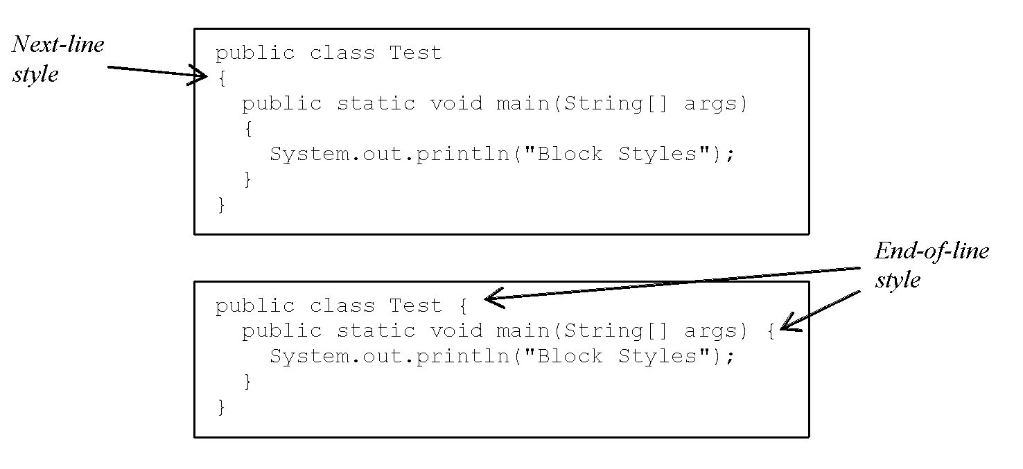
Block Styles
Use end-of-line style for braces.
‹#›

